Slide 1

The MONICA Project and Dataset
By the DataPros
(Lucas Belury, Marta Matosas Fonolleda,
Anwesha Tomar, Steven Towers, Sandra Valdes Salas)
Notes:
Intro, everyone

Slide 2

Monica Dataset Methodology
In 1979 the World Health Organization commissioned the MONICA project
The MONICA project is a multinational study that to assesses mortality for those diagnosed with cardiovascular disease (38 populations and 21 countries).
Cross-sectional study in which survey data was collected on random samples to provide estimates of the levels and changes of known cardiovascular disease risk factors
Notes:
MONICA - Multinational Monitoring of Trends and Determinants in Cardiovascular Disease.
The data was collected between 1985 and 1993 and includes a variety of potential risks associated with mortality and cardiovascular disease
Participants in the study were almost exclusively from Europe and North America. This was due to access to diagnostic equipment in the ‘developing’ world.

Slide 3
Monica Dataset Methodology
This project drew on individuals almost exclusively from Europe and North America.
The data is heavily skewed toward men. However according to the WHO of the 17.9 million annual cardiovascular deaths more than half are women.
Notes:
MONICA - Multinational Monitoring of Trends and Determinants in Cardiovascular Disease.
The data was collected between 1985 and 1993 and includes a variety of potential risks associated with mortality and cardiovascular disease
Participants in the study were almost exclusively from Europe and North America. This was due to access to diagnostic equipment in the ‘developing’ world.

Slide 4
The Dataset - Categorical Variables
Variable (n = 6,367) | Male | Female | Not Known | Column1
Sex | 4,605 (72.3%) | 1,762 (27.77%) | 0
Column1 | Yes | No | Not Known | Column2
High Cholesterol | 1,840 (28.9%) | 3,294 (51.7%) | 1,233 (19.4%)
Angina | 1,919 (30.1%) | 3,473 (54.6%) | 975 (15.3%)
High Blood Pressure | 2,877 (45.2%) | 2,542 (39.9%) | 948 (14.9%)
Stroke | 560 (8.8%) | 4,881 (76.7%) | 926 (14.5%)
Diabetes | 818 (12.9%) | 4,664 (73.3%) | 885 (13.9%)
Previous Myocardial Infarction | 1,511 (23.7%) | 4,211 (64.7%) | 734 (11.5%)
Hospitalization | 4,442 (69.8%) | 1,925 (30.2%) | 0
Column1 | Current | Ex Smoker | Never Smoker | Not Known
Smoking Status | 2,051 (32.2%) | 1,938 (30.4%) | 1,460 (22.9%) | 918 (14.4%)
Notes:
Mention Age and Year of Onset as well

Slide 5
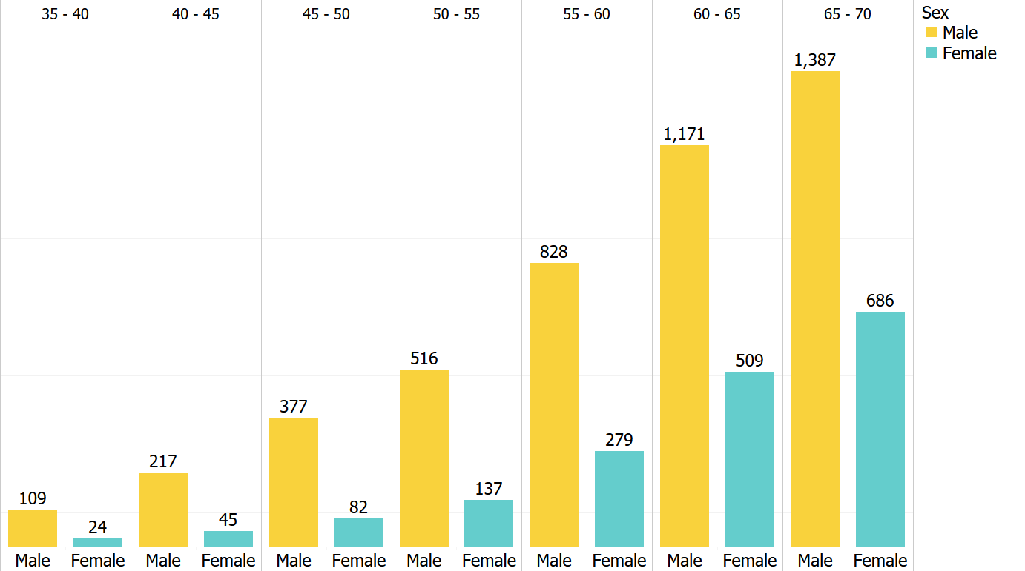
The Dataset - Age at Diagnosis
Notes:
age for 6367 participants was recorded.
Average age of diagnosis is: 59.42
Median of age is : 61
The maximum amount of data is recorded in between the ages of 60-70.
Based on this information we can tell, that the data is skewed to the right.

Slide 6
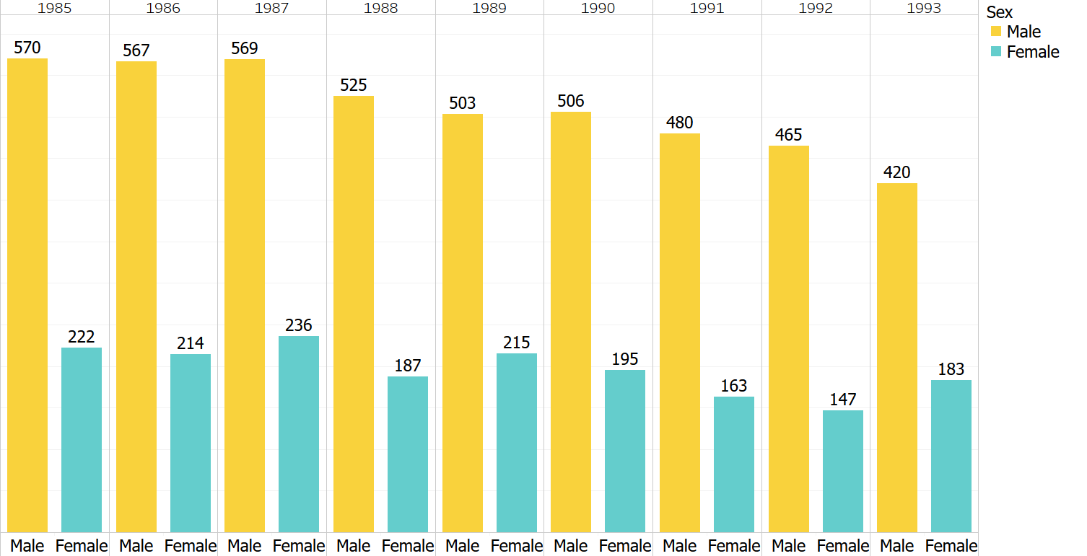
The Dataset - Year of Onset
Notes:
the data was collected from the year 1985-1993.
For men the amount of data collected decreases over time, while for women it remains constant.- OR near normal distribution.
Does that mean that diagnosis/ treatment improved with time?

Slide 7
SMART Question Part 1
Among a random sample between 1985 and 1993, what are the specific demographic and physiological indicators that are associated with the outcome of mortality from cardiovascular disease and what are the strengths of those associations?
We mainly answered this with Chi-Square and some Univariate Logistic Regression.

Slide 8
Key Takeaways from Part 1
Of those risk factors that were associated with the outcome, most lead to an increased odds in mortality.
Interestingly, having high cholesterol lead to a decreased odds of mortality from cardiovascular disease.
Hospitalization status produced a very extreme odds ratio - 0.0004.
For those who died, many likely never made it to the hospital following the event. Potential confounding by severity of event?
Mortality status was independent of a participant’s sex, however, when stratified by sex, some differences in independence for certain predictors - suspected interaction.

Slide 9
SMART Question Part 2
Among a random sample between 1985 and 1993, after stratifying the data by sex, what combination of demographic and physiological predictors most accurately predict participant outcome (live/dead)?
We are using four models to predict the outcome of our dataset: Multivariable Logistic Regression, KNN, Decision Trees, Random Forest.

Slide 10

Multivariable Logistic Regression
Much of our data is categorical in nature and has a binary outcome of live/dead.
In part 2, we built upon our univariate logistic regression analysis by adding additional predictors to build a multivariable logistic regression model.
We used a forward stepwise feature selection method for building our logistic regression model in order to identify the best combination for predicting the outcome.
The used McFadden to measure the variation of outcome explained by the explanatory variables in the model.
McFadden's R squared measure is defined as:
Where Lc is the maximized likelihood value from the current fitted model and Lnull denotes the corresponding value but for the null model - the model with only an intercept and no covariates.
Notes:
The forward selection strategy: we add variables one-at-a-time until we cannot add any variables that improve the model (as measured by adjusted R2). Open Intro Statistics, p. 380
Adjusted R2 describes the strength of a model t, and it is a useful tool for evaluating which predictors are adding value to the model, where adding value means they are (likely) improving the accuracy in predicting future outcomes. Open Intro Statistics, p. 378
McFadden is another evaluation tool we can use on logit regressions. This is part of what is called pseudo-R-squared values for evaluation tests.
McFadden calculates the percentage of variation in y that is explained by the explanatory variables (see R_LogReg_2019F.Rmd)
Logistic regression models are fitted using the method of maximum likelihood

Slide 11
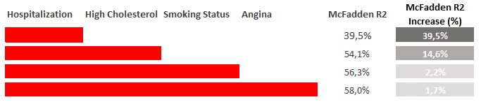
Multivariable Logistic Regression Results - Female
Target is Outcome

Slide 12
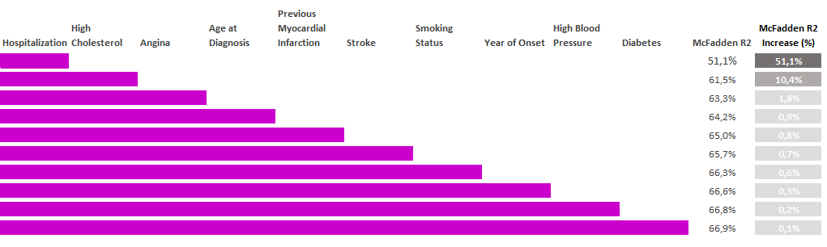
Multivariable Logistic Regression Results - Male
Target is Outcome

Slide 13
Multivariable Logistic Regression Key Takeaways
Non-meaningful increases in R² values after adding 3 predictors to the subsetted models.
Our full models are still not fitting the data very well - only ~55-65% of the variance in the outcome is predicted by the independent variables
The male subset fits the data better than the female subset, which we suspect is due to the higher power obtained from the sample sizes (men= 4605; women= 1762)

Slide 14
K Nearest Neighbor Methodology
Classify outcome based on all risk factors.
At random, 38% chance of choosing ‘dead’.
At random, 65% chance of choosing ‘live’.
Classify outcome based on risk factors for men and women.
Preparation of dataset:
Data divided into training (70%) and test (30%) sets.
Created separate y-labels.
Age of diagnosis and year of onset binned.

Slide 15
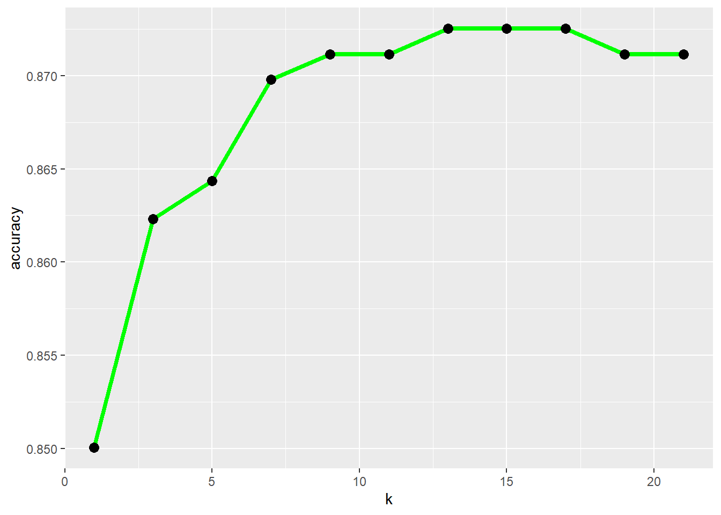
K Nearest Neighbor with All Variables
k | Accuracy | ‘live’ correctly classified | ‘dead’ correctly classified
7 | 87.7% | 99.5% | 65.3%
5 | 86.8% | 98.1% | 65.1%
3 | 86.03% | 96.5% | 66.1%
Notes:
Tested the classifier with different k values.

Slide 16
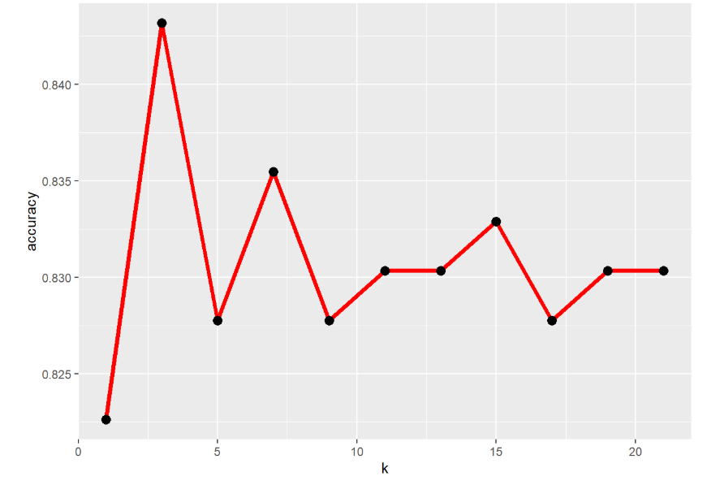
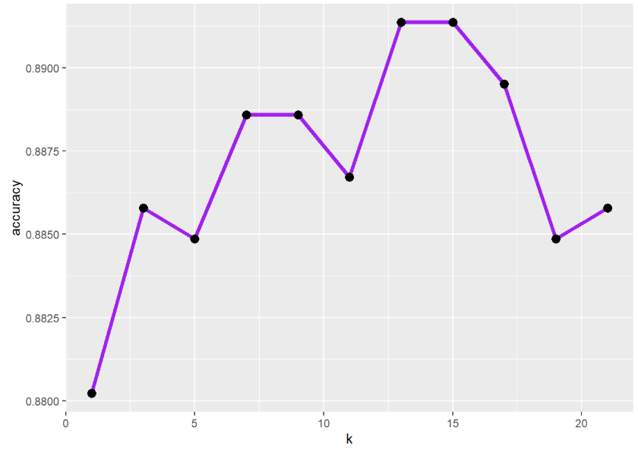
K Nearest Neighbor Stratified by Sex
Female k=3
Male k=13
Predictors | Accuracy | ‘live’ correctly classified | ‘dead’ correctly classified
All | 84% | 97% | 56%
Subset 4 risk factors | 86% | 100% | 56%
Predictors | Accuracy | ‘live’ correctly classified | ‘dead’ correctly classified
All | 89% | 99% | 68%
Subset 6 risk factors | 89% | 99% | 71%
Notes:
Women. Combination of 4 predictors that yields the highest accuracy: hospitalization, high cholesterol, smoking status, diabetes.
Men. Combination of 6 predictors that yields the highest accuracy: Hospitalization, year of onset, age of diagnosis, high blood pressure, previous myocardial infarction, and stroke

Slide 17
K Nearest Neighbor Key Takeaways
Model performs well for classifying ‘live’ but with limitations for classifying ‘dead’.
As the K value increases so does the predictive quality of the KNN analysis for ‘live’ but not for ‘dead’ for the entire dataset.
7 K values were optimal for ‘live’ while 3 k values were optimal for ‘dead’ for the entire dataset.
For the Female subset the optimal K value was 3; for the Male subset the optimal K value was 13.

Slide 18
Decision Tree & Random Forest
Step 1 - Stratified data by sex.
Step 2 - Used Bayesian Information Criteria to determine most significant factors.
Step 3 - Built decision trees using the variables found significant in Bayesian Information Criteria.
Step 4 - Used Random Forest to find the accuracy of predicting death by sex.
Notes:
The dataset was first stratified by sex, then we found the most significant factors using Bayesian Information Criteria. The decision tree was then built using these factors. Lastly we used random forest to find the accuracy of predicting death.

Slide 19
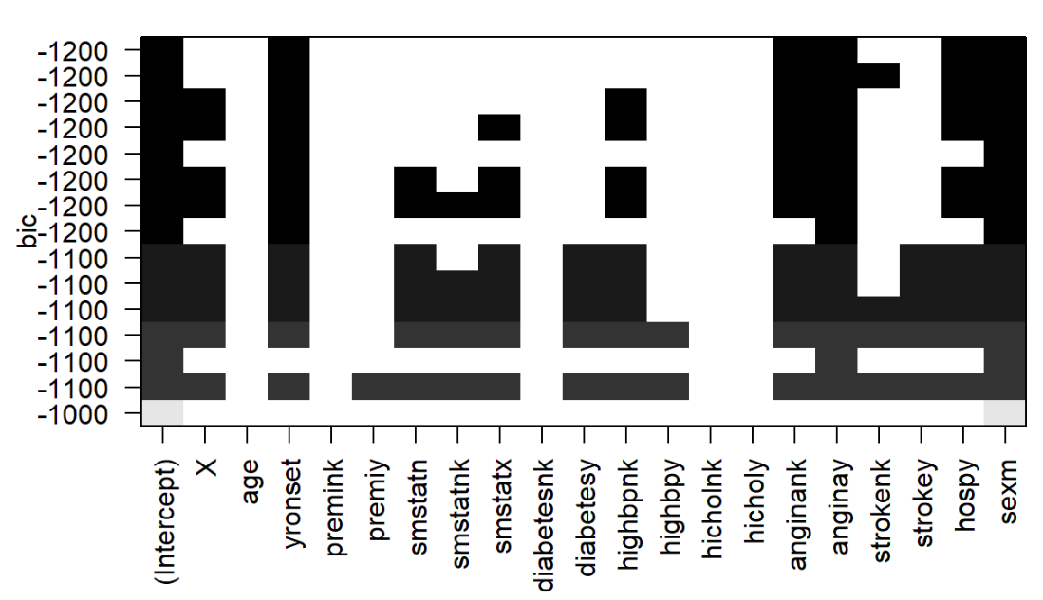
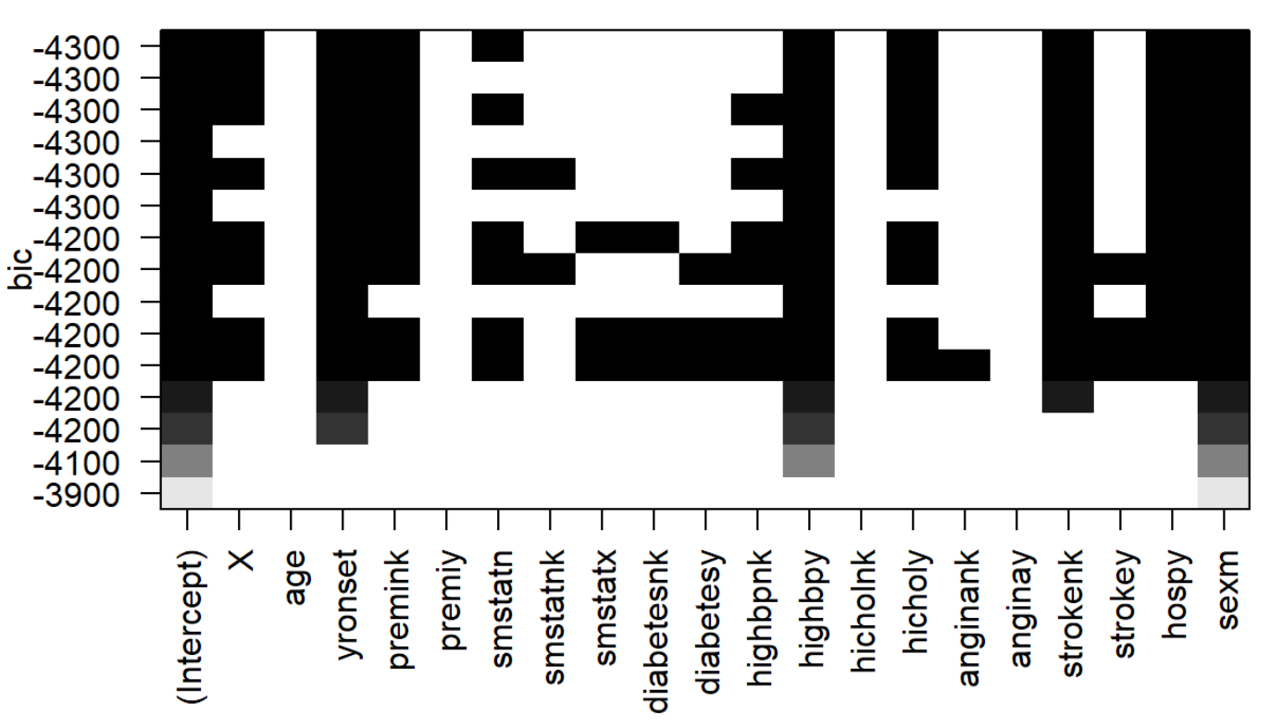
Feature selection using Bayesian Information Criteria
BIC for Females:
BIC for Males:
Notes:
Here we used the model with the lowest BIC value.
Females: hospitalization, angina and year of ronset are the most significant.
Males:we have 7 important features, according to BIC age of diagnosis is the only factor that is considered unimportant for males.

Slide 20
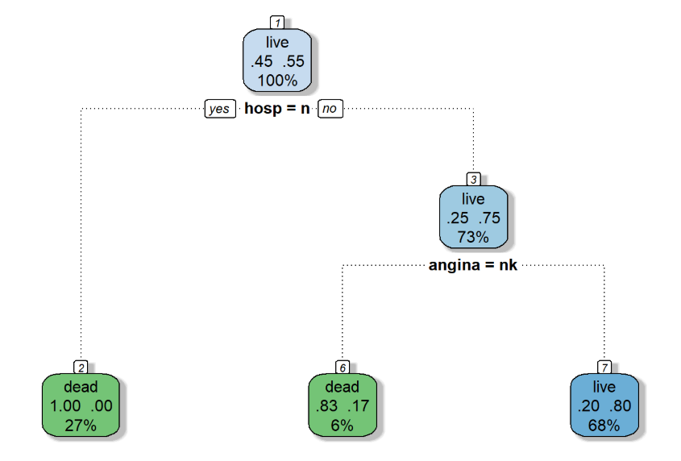
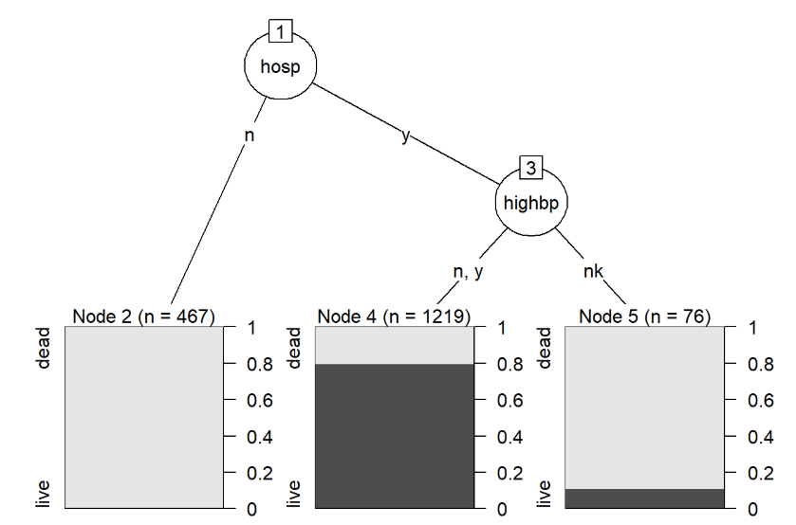
Decision Tree Subset by Female
Decision tree generated after feature selection.
Decision tree without feature selection, using all the features.
Notes:
The decision tree that was generated after feature selection, found hospitalization and angina to the most important factors. When we generated a tree using the entire dataset we found that hospitalization and high blood pressure were the most important features.

Slide 21
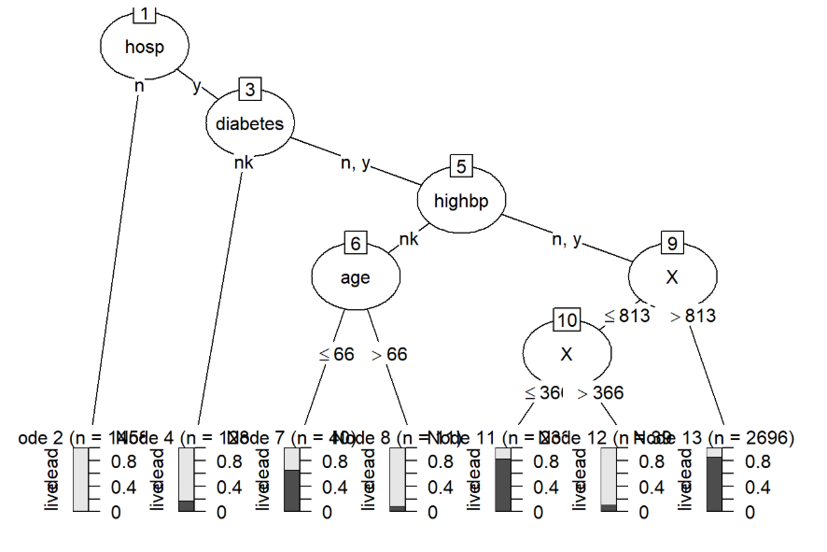
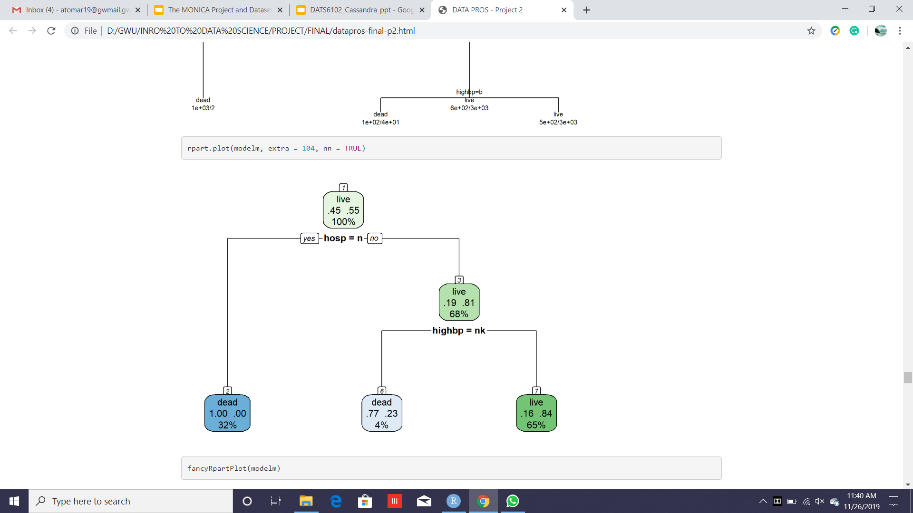
Decision Tree Subset by Male
Decision tree generated after feature selection.
Decision tree without feature selection, using all the features.
Notes:
The decision tree that was generated after feature selection, found hospitalization and high blood pressure to the most important factors. When we generated a tree using the entire dataset we found that hospitalization, diabetes, high blood pressure and age of diagnosis were the most important features.

Slide 22
Random Forest Analysis
STRATIFIED BY SEX:FEMALE
ERROR RATE: 14.8%
STRATIFIED BY SEX:MALE
ERROR RATE: 10.9%
Confusion Matrix | DEAD | LIVE | CLASS ERROR
DEAD | 377 | 164 | 0.303
LIVE | 18 | 674 | 0.026
Confusion Matrix | DEAD | LIVE | CLASS ERROR
DEAD | 1131 | 308 | 0.214
LIVE | 44 | 1740 | 0.024
Notes:
Random forest used 500 trees for the analysis. It was used to predict death. The error rate for females was higher than that for males.

Slide 23
Key Takeaways for Decision Trees
Based on subsetting using the BIC Analysis
Decision Tree analysis females: Hospitalization and Angina are the most significant features
Decision Tree analysis males: Hospitalization and High Blood Pressure are the most significant for males.
Without feature selection it is seen that hospitalization and high blood pressure are the most significant for females.
Without feature selection it is seen that hospitalization, age at onset, diabetes and high blood pressure are the most significant for males.

Slide 24
Final Key Conclusions
Full model does not fit the data very well
Hospitalization status was the strongest predictor of cardiovascular mortality
Analysis would have been more robust if quantitative variables were collected
Study validity
Moderate internal validity: + strong sampling methods, - high rate of missing values
Moderate external validity: representative to a European male population

